Slide 1
Finding an Optimal Route based on Crowding and Travel Time

Slide 2
GPS Data Extraction
ETM Data Extraction
Travel Time Estimation and Prediction
Crowding Data Estimation and Prediction
Minimum Crowding Path Algorithm
Optimal Route

Slide 3
GPS Data Extraction
ETM Data Extraction
Travel Time Estimation and Prediction
Crowding Data Estimation and Prediction
Literature Review
Formulating Shortest Path Problem
Minimum Crowding Path Algorithm
Optimal Route

Slide 4
Crowding Data Extraction, Estimation, Prediction

Slide 5
ETM Data Extraction
Input -> Raw ETM Data
Output -> Route/Schedule Level, Trip Level Ticket data
Crowding Estimation
Input -> Route/Schedule Level, Trip Level Ticket data
Output -> Route/Schedule Level Demand data, Real-Time Trip Level Crowding Level data
Crowding Prediction
Input -> Historical Route Level Demand data
Output -> Real-Time Demand data

Slide 6
ETM Data Cleaning
Time discrepancies
Input -> Raw ETM Data
Output -> Clean ETM Data
ETM Data Extraction
Route level data extraction
Trip level data extraction
Input -> Clean ETM data
Output-> Route level / trip level ticket data
Stages ordering
Manual ordering for select routes/schedules
Plotting the stages in Google Maps

Slide 7
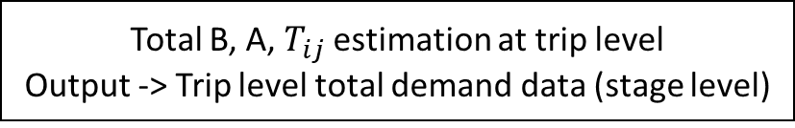
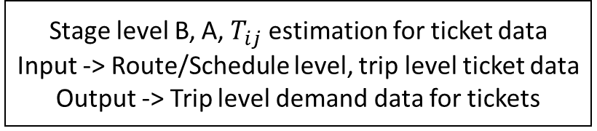
Extracted ETM data
Stage level B, A, $T_{ij}$ estimation for ticket data
Input -> Route/Schedule level, trip level ticket data
Output -> Trip level demand data for tickets
Pass holder model
Input -> Trip Level Demand data for tickets
Output -> Trip level Demand data for tickets and pass holders
Input -> Stage level ETM Data, Number of stops for each stage
Output -> Grouped Stop Level Tickets
Mean shift Clustering
Kernel Density Optimization
Changepoints/Breakpoints method
Demand Prediction
Input -> Testing data, ML Models
Output -> Real time demand data at stage
Total B, A, $T_{ij}$ estimation at trip level
Output -> Trip level total demand data (stage level)
Determination of Crowding Level
Input -> Real time demand data at stage, Stages ordered file
Output -> Real time demand data with crowding level
From State Space Equation
Crowding Thresholds Determination
Input -> Trip level total demand data
Output -> Crowding Thresholds

Slide 8
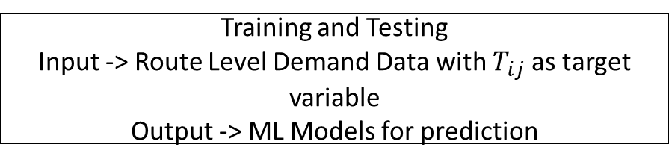
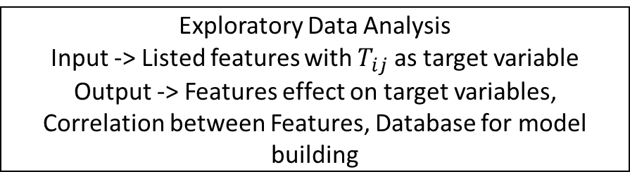
Features Extraction
Input -> Trip level demand data
Output -> Listed Features for prediction
Crowding Prediction
Exploratory Data Analysis
Input -> Listed features with $T_{ij}$ as target variable
Output -> Features effect on target variables, Correlation between Features, Database for model building
Training and Testing
Input -> Route Level Demand Data with $T_{ij}$ as target variable
Output -> ML Models for prediction
Demand Prediction
Input -> Testing data, ML Models
Output -> Real time demand data at stage

Slide 9
Travel Time Extraction, Estimation, Prediction

Slide 10
ETM Data Extraction
Input -> Raw ETM Data
Output -> Route/Schedule Level, Trip Level Ticket data
Travel Time Estimation
Input -> Route/Schedule Level, Trip Level Ticket data
Output -> Route/Schedule, Trip Level Stage-Stage Travel Time Estimates
Travel Time Prediction
Input -> Historic Route level Stage-Stage Travel Time estimates
Output -> Future Trip Stage-Stage Travel Time Estimates

Slide 11
ETM Data Extraction
ETM Data Cleaning
Time discrepancies
Input -> Raw ETM Data
Output -> Clean ETM Data
Route level data extraction
Trip level data extraction
Input -> Clean ETM data
Output-> Route level / trip level data
Stages ordering
Manual ordering for select routes/schedules
Plotting the stages in Google Maps

Slide 12
Decision point: For each stage pair, whether ETM data is sufficient for travel time estimation
Stage-Stage Approximate Travel Time Estimation (ETM)
Input -> Route/Schedule level, trip level ticket data, Stages ordered file
Output -> Stage Level Travel Time Estimates
Extracted ETM & GPS data
ETM-GPS Mapping
Input -> Route/Schedule Level, Trip Level Ticket data, ETM-GPS Mapping file
Output -> GPS data for Route/Trip
Stage-Stage Actual Travel Time Estimation (GPS)
Input -> Route/Trip level GPS data
Output -> Stage-Stage Travel Time Estimation
Model for estimation and prediction of Travel Time using ETM data and GPS data

Slide 13
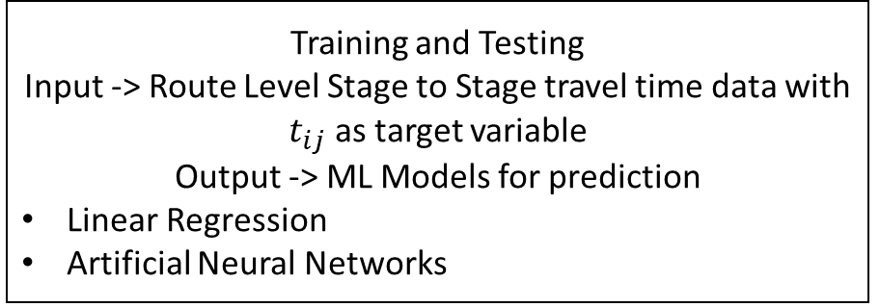
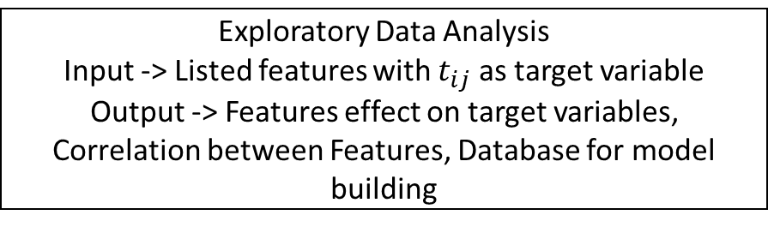
Features Extraction
Input -> Trip level Stage to Stage Travel time data
Output -> Listed Features for prediction
Travel Time Prediction
Exploratory Data Analysis
Input -> Listed features with $t_{ij}$ as target variable
Output -> Features effect on target variables, Correlation between Features, Database for model building
Training and Testing
Input -> Route Level Stage to Stage travel time data with $t_{ij}$ as target variable
Output -> ML Models for prediction
Linear Regression
Artificial Neural Networks
Travel Time Prediction
Input -> Testing data, ML Models
Output -> Travel time data estimates for a future trip
Pattern Recognition Methods
Kalman Filtering for Real Time Prediction

Slide 14
Travel Time Prediction
Machine Learning Applications
Input -> Features like Dwell Time, Crowding
Output -> Future Travel Time Estimates
Linear Regression
Artificial Neural Networks
Pattern Recognition Methods
Kalman Filtering for Real Time Prediction

Slide 15
Optimization

Slide 16
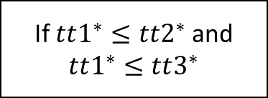
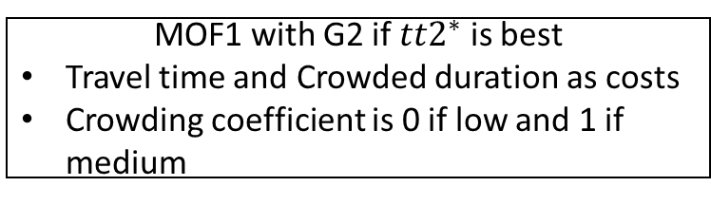
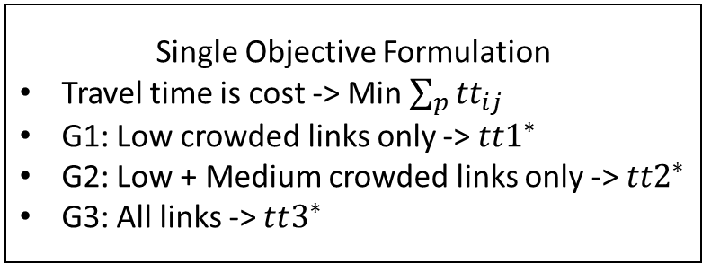
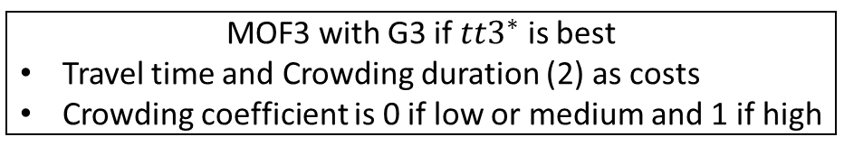
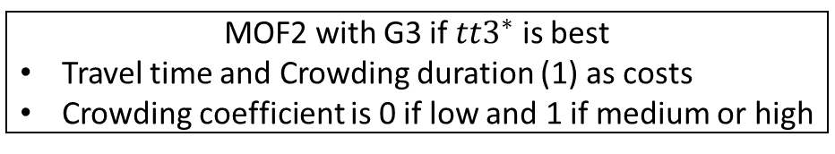
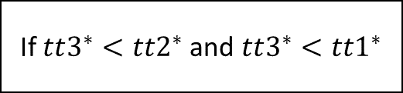
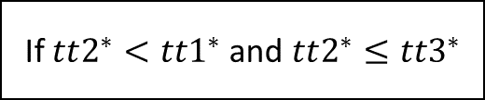
Single Objective Formulation
Travel time is cost -> Min $\sum_{p}{{tt}_{ij}}$
G1: Low crowded links only -> $tt1^{∗}$
G2: Low + Medium crowded links only -> $tt2^{∗}$
G3: All links -> $tt3^{∗}$
If $tt2^{∗}<tt1^{∗}$and $tt2^{∗}≤tt3^{∗}$
Minimum Crowding Path Algorithm
MOF1 with G2 if $tt2^{∗}$ is best
Travel time and Crowded duration as costs
Crowding coefficient is 0 if low and 1 if medium
If $tt1^{∗}≤tt2^{∗}$and $tt1^{∗}≤tt3^{∗}$
If $tt3^{∗}<tt2^{∗}$and $tt3^{∗}<tt1^{∗}$
KSP based algorithm for MOF1
Optimal path reached
Non Dominated Set 1
MOF2 with G3 if $tt3^{∗}$ is best
Travel time and Crowding duration (1) as costs
Crowding coefficient is 0 if low and 1 if medium or high
MOF3 with G3 if $tt3^{∗}$ is best
Travel time and Crowding duration (2) as costs
Crowding coefficient is 0 if low or medium and 1 if high
KSP based algorithm for MOF2
Non Dominated Set 2
Candidate Set
Combine ND2, ND3
KSP based algorithm for MOF3 Non Dominated Set 3
Non Dominated Set wrt $tt$, crowding duration 1, crowding duration 2

